Slide 1
Digital Health Technology Assessment: Remote Patient Monitoring in Type 2 Diabetes
Josh Carlson. PhD, MPH Senior Partner, Curta Prepared for the Peterson Health Technology Institute

Slide 2
Clinical Impact: Systematic Literature Review

Slide 3
Systematic Literature Review: High Level Protocol
Category | Inclusion Criteria |  | Exclusion Criteria
Population | Adults living with type II diabetes mellitus |  | Adults or children with Type 1 diabetes mellitus Children with Type 2 diabetes mellitus
Interventions | Blood glucose monitoring (non-continuous) with associated mobile or web application. |  | Continuous glucose monitoring systems Standalone health applications and person devices Smart insulin pens and pen caps Standalone insulin pumps Non-invasive sensors
Comparators | Standard of care (fingerstick blood glucose meter) or usual care. |  | Not applicable
Outcomes | HbA1c level Body weight Cardiovascular risk factors Cardiovascular events Safety of connected blood glucose meters PROs Safety User experience | Patient satisfaction Adherence Use of medication HCRU (ED, hospitalization, clinic visits) Shifts in care delivery driven by connected blood glucose meters Health equity | Not applicable
Study designs | Clinical trials (phase 2 or 3; single arm or controlled) Observational (prospective and retrospective) studies Systematic reviews and meta-analysis |  | Commentary, letters, editorials, opinions, study protocols Non-systematic and narrative reviews Case reports or series
Geography | Global |  | Interventions not approved or available in the United States
Language | Articles and abstracts published in English |  | Not applicable
Date of publication | Databases: 2013 to 2023 (MEDLINE[via PubMed] and EMBASE] Conferences: 2021 to 2023 (Conference proceedings) |  | Not applicable
Outcomes
HbA1c level
Body weight
Cardiovascular risk factors
Cardiovascular events
Safety of connected blood glucose meters
PROs
Safety
User experience
Patient satisfaction
Adherence
Use of medication
HCRU (ED, hospitalization, clinic visits)
Shifts in care delivery driven by connected blood glucose meters
Health equity
3

Slide 4
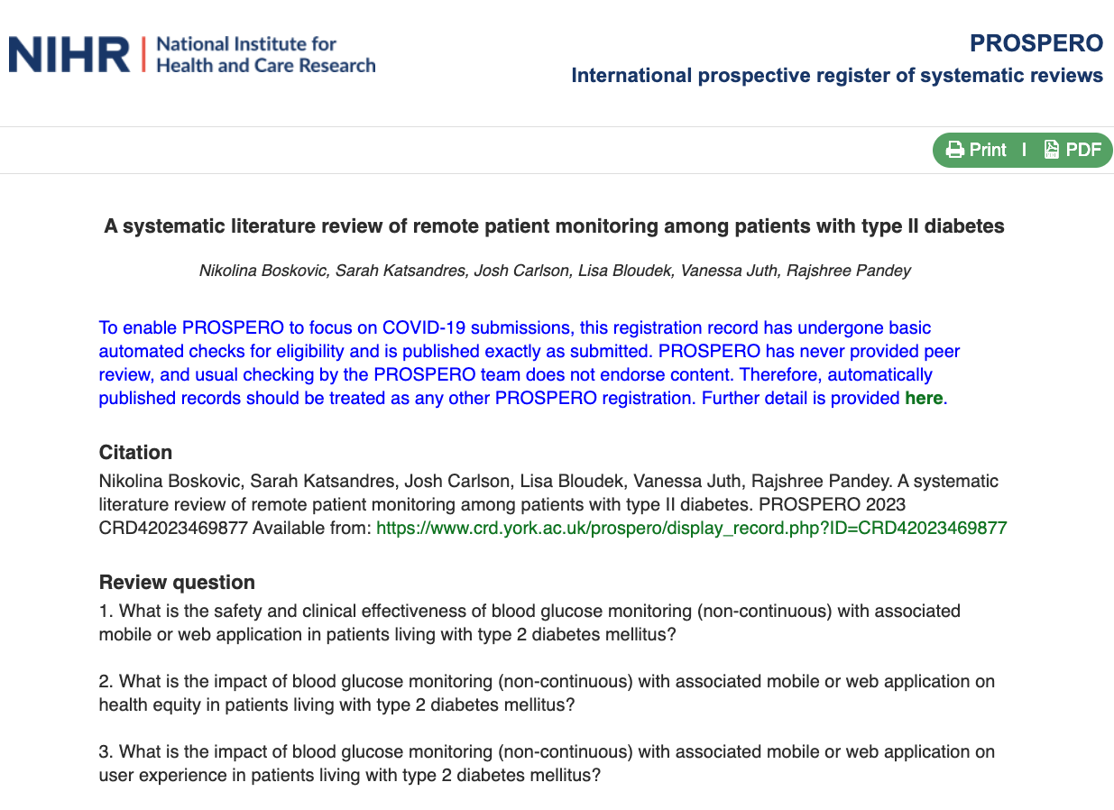
Systematic Literature Review
Protocol published and publicly available
4

Slide 5
Economic Impact: Budget Impact Analysis

Slide 6
Overarching Economic Impact Framework for DHTs
Health Care Resource Use Impact Categories
Economic Impact
(Resource Use X Unit Cost)
Evidence
Indirect Cost Impacts via
Clinical Outcomes
Evidence linking interventions to clinical outcomes
Evidence linking clinical outcomes to resource use
Physician Visits
Specialty Visits
Imaging
Laboratory Tests
Medications
Emergency Room Visits
Hospitalizations
Surgeries
Digital Health Technology Vs. Usual Care
Payer:
Reimbursements for Intervention
Reimbursements for HCRU
Direct Cost Impacts
6

Slide 7
Analysis Decision Problem - Diabetes
Population | Adults with Type 2 diabetes
Model Approach | Closed cohort
Perspective | Commercial, Medicare and Medicaid payer perspectives
Intervention | Non-continuous blood glucose monitoring with associated mobile or web application that are part of a comprehensive T2D control programs; interventions to be evaluated at the company product-specific level
Comparators | Usual care (fingerstick blood glucose meter)
Cost categories | Intervention costs Outpatient care costs Pharmacy costs Inpatient care costs
Budget impact outputs | Total costs for remote patient monitoring and usual care scenarios Incremental cost per end user adhering to DHT Incremental cost per 1,000 users reflecting adherence Incremental cost per user per month Incremental cost per member per month
Scenario analyses | Analysis with threshold prices to achieve different levels of cost savings
Time horizon | 1-3 years
Software | Excel
7

Slide 8
Type 2 Diabetes Budget Impact Schematic: Indirect Approach
Drug Costs
Connected glucose meter
HbA1c
Outpatient Costs
Diagnosed Type 2 diabetes patients recommended to receive non-continuous blood glucose monitoring
Acute Care Costs
Drug Costs
Unconnected glucose meter
HbA1c
Outpatient Costs
Acute Care Costs
Impact of connected glucose monitoring devices on HbA1c level will be informed by the SLR
Impact of HbA1c to healthcare costs will be informed by a retrospective claims analysis¹
1. Boye KS, Lage MJ, Thieu VT. The Association Between HbA1c and 1-Year Diabetes-Related Medical Costs: A Retrospective Claims Database Analysis. Diabetes Ther. 2022 Feb;13(2):367-377.
8

Slide 9
Diabetes Patient Population Funnel
Hypothetical Million-Member Health Plan
1,000,000
Assumed plan population
77.7%
% Adults¹
11.3%
Prevalence of diagnosed diabetes²
95%
23,322 to 58,305
% Type 2 diabetes³
15%
% Use insulin to control blood blood glucose levels⁴
55%
% Utilization of self-monitoring blood glucose device⁵
6,881
Total potential users
#
#
US Census Bureau. Age and Sex Composition in the United States: 2022. Available at: https://www.census.gov/data/tables/2022/demo/age-and-sex/2022-age-sex-composition.html. Accessed September 18, 2023.
Centers for Disease Control and Prevention. National Diabetes Statistics Report website. https://www.cdc.gov/diabetes/data/statistics-report/index.html. Accessed September 18, 2023.
Centers for Disease Control and Prevention. Type 2 Diabetes. https://www.cdc.gov/diabetes/basics/type2.html#:~:text=More%20than%2037%20million%20Americans,adults%20are%20also%20developing%20it. Accessed September 18, 2023.
Willner S, Whittemore R, Keene D. "Life or death": Experiences of insulin insecurity among adults with type 1 diabetes in the United States. SSM Popul Health. 2020 Jun 27;11:100624.
Perez-Nieves M, Juneja R, Fan L, et al. Trends in U.S. Insulin Use and Glucose Monitoring for People with Diabetes: 2009-2018. J Diabetes Sci Technol. 2022 Nov;16(6):1428-1435..
9

Slide 10
Sample Budget Impact Results Table
Payer Costs (HCRU and DHT Care)
Outcomes | Scenario without RPM | Scenario with RPM | Budget Impact
Total cost | $X | $Y | =($Y - $X)
Cost per 1,000 users | $X | $Y | =($Y - $X)
Cost per user per month | $X | $Y | =($Y - $X)
Cost per-member per-month | $0.XX | $0.YY | =($0.YY - $0.XX)
10

